Slide 1


Alpha Quest Algorithmic Trading Engine
Group 5 Members:
ZHANG Feifan
ZHENG Xiaotong
LI Xutao
DAI Jingxian
223040185
223040208
223040183
223040201

Slide 2
Contents
01
Data Preprocess & Infrastructure
02
Strategy-Algorithmic trading
Data Source, Class and Data Reading
Factor construction and order function
03
TCA Analysis
04
GUI System
Cost Decomposition and Execution Quality
Current Holdings & Trade Log & TCA Analysis
05
Results
Return & Sharpe & MDD

Slide 3

01
Data Preprocess & Infrastructure
Data Source, Class and Data Reading

Slide 4
Data Foundation - Data Source
Minute-level trading data of CSI 300 Index component stocks: Trading_Date; Trading_Time; Open; High; Low; Close; Volume; Amount
Function：
Providing Trading Decision Basis
Tracking Index Performance
Security_Id | Trading_Date | Trading_Time | Open | High | Low | Close | Volume | Amount
000001.SZ | 20240102 | 20240102093000000 | 9.39 | 9.39 | 9.39 | 9.39 | 6301 | 5,916,310.00
000001.SZ | 20240102 | 20240102093100000 | 9.4 | 9.42 | 9.36 | 9.37 | 43232 | 40,598,438.00
000001.SZ | 20240102 | 20240102093200000 | 9.37 | 9.38 | 9.37 | 9.38 | 7131 | 6,686,130.00
Weight of Constituents in the CSI 300 Index:
Con_Code; Weight
Function：
Guiding Capital Allocation
Index_Code | Con_Code | Trade_Date | Weight
000300.SH | 600519.SH | 20240102 | 6.1717
000300.SH | 601318.SH | 20240102 | 2.4772

Slide 5
Infrastructure - RunParams Class & Portfolio Class
RunParams Class
Portfolio Class
Stores information about the parameters required for the algorithm to run
Start date: 20240101
End date: 20240412
Run type: Backtest
Commission rate: 0.0003
Algo type: Vwap; Twap
Order type: volume; price
The role of this class in the algorithm is to manage and track information about the portfolio
Current position
Available cash
Total value
Returns
Starting cash
Position value
class RunParams:
def __init__(self) -> None:
self.start_date = None # 起始日期
self.end_date = None # 终止日期
self.run_type = None # 运行类型（回测/模拟）
self.commission_rate = None # 佣金费率
self.algo_type = None # 算法类型
self.algo_params = None # 算法参数
self.order_type = None # 订单类型
class Portfolio:
def __init__(self, starting_cash=5_000_000):
self.positions = {} # 记录当前持仓
self.available_cash = starting_cash # 记录当前可用资金
self.total_value = starting_cash # 记录当前总资产
self.returns = 0 # 记录当前收益
self.starting_cash = starting_cash # 记录初始资金
self.position_value = 0 # 记录当前持仓市值

Slide 6
Infrastructure - Context Class
Context Class
Provide a context in which we can store and track various information about the algorithm as it runs, including parameters, portfolios, current time, stock pools, benchmark indexes and transaction cost analysis etc.
Data record variable: current_dt; previous_dt; Universe; benchmark
Universe: The stock pool represents all the constituent stocks of CSI 300
Benchmark: Representing the CSI 300 Index
Data output variable: trade_book; target_book; position_book; total_value_book; tca_book
class Context:
def __init__(self, run_params, portfolio):
self.run_params = run_params # RunParams类
self.portfolio = portfolio # Portfolio类
self.current_dt = run_params.start_date # 记录当前时间
self.previous_dt = run_params.start_date # 记录上一个交易日
self.universe = None # 股票池
self.benchmark = None # 基准指数
self.trade_book = {} # 交易记录本
self.target_book = pd.DataFrame(columns=self.universe)
self.position_book = None # 交易持仓
# 新建一个pd用于存放total_value_book
self.total_value_book = pd.DataFrame(columns=['total_value'])
self.tca_book = {}

Slide 7
Infrastructure - Data Reading
Retrieve tick data for the corresponding stock code.
Set the user's token to access financial data API.
Retrieve real-time data from the TS library port based on the stock code.
Data processing: Combine DATE and TIME into one datetime column.
Read minute-level stock data from the database.
Retrieve data according to the database path
Data format conversion
Convert strings and the time to datetime format.
Set the time column as the index.
Filter out data within the specified time range.

Slide 8
02
Strategy-Algorithmic trading
Factor construction and order function

Slide 9
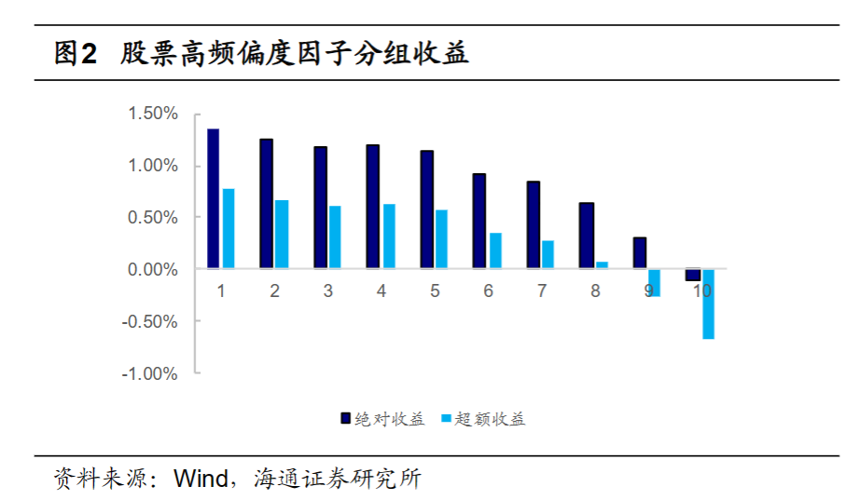
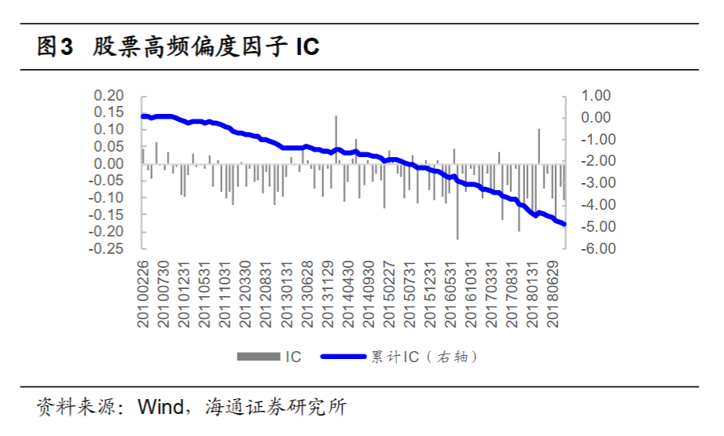
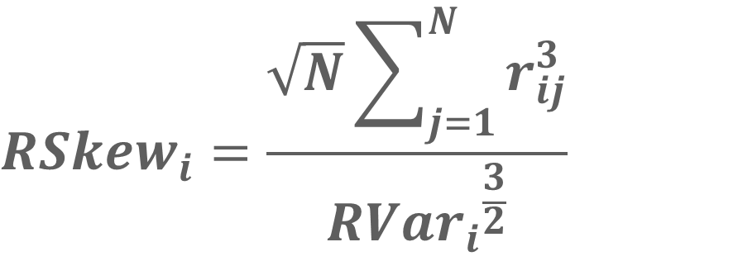
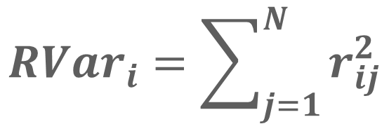
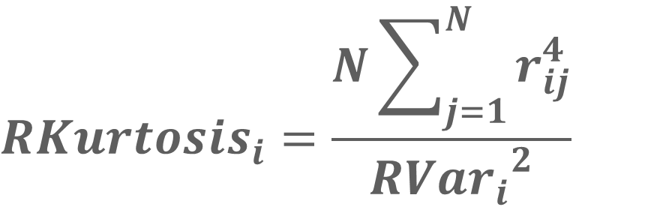
Strategy - Factor construction
Factor construction
High frequency realized variance
$$R{Var}_{i}=\sum_{j=1}^{N}{r_{ⅈj}^{2}}$$
Amaya et al. (2011) found a connection between intra-day high-order moments and future returns of stocks. ¹
Utilizing intra-day tick-by-tick data of stocks, they constructed a high-frequency realized variance indicator
𝑟𝑖𝑗 represents the intra-day 1-minute logarithmic return series of stock 𝑖 (𝑗 = 1, ⋯ , 𝑁+), with factor values as the moving average of indicators over the past 20 days.
$$R{Skew}_{i}=\frac{\sqrt{N}\sum_{j=1}^{N}{r_{ⅈj}^{3}}}{{R{Var}_{i}}^{\frac{3}{2}}}$$
High frequency realized skewness
$$R{Kurtosis}_{i}=\frac{N\sum_{j=1}^{N}{r_{ⅈj}^{4}}}{{R{Var}_{i}}^{2}}$$
High frequency realized kurtosis
1. Reference: 海通证券(2018) _金融工程_高频量价因子在股票与期货中的表现

Slide 10
Strategy - Factor construction
Factor value calculation
Data Cleaning:
Replace any infinite values encountered during the process with 0
Compute the rolling average of factor values within the rolling calculation window length.
Calculate the daily factor values of logarithmic returns
Computing method:
Factor buying method: Rolling percentile method
Window period: 20 days
Percentage of bulls: Top 10%
Adjust warehouse frequency: Daily

Slide 11
Strategy - Customize the order function
1
Order directly by share count
2
Order with the desired position
Order_by_volume(stock_code, volume)
Order_target_volume(stock_code, volume)
Purpose: Based on a given ticker symbol and number of shares to at the current market price. perform a buy or sell operation
Purpose: calculates the quantity of stocks to buy or sell in order to adjust the current position to match the target position, based on the provided symbol and target position quantity.
Input: Order_by_volume('X', 100)
Input: Order_target_volume('X', 100)
Execute: Check X hold_volume=80
Execute: Buy or sell 'X' in 100 shares.
Execute: Buy 'X' in 20 shares.

Slide 12
Strategy - Place order function
3
4
Order by value/price
Order by (Target - Current value) /price
Order_by_value(stock_code, value)
Order_target_value(stock_code, value)
Purpose: Buy or sell a stock based on the given value and the current stock price, ensuring that the order amount is consistent with the given value.
Purpose: Make sure that the position value is consistent with the target value by placing an order to buy or sell the stock based on the target value and the current position.
Input: Order_target_volume(X, 3000)
Input: Order_target_volume('X’, 10000)
Execute: Check X price = 100
Execute: Check X price = 100 Check X hold value = 8000
Execute: Buy X in 3000/100=30 shares
Execute: Buy X in (10000-8000)/100=20 shares

Slide 13
Strategy - Algorithmic trading order function
Process
TWAP (Time Weighted Average Price)
Calculate the target trading volume for each batch based on the total trading volume and TWAP parameters.
It divides the total trading volume into multiple batches and executes orders over a specified period of time to achieve trading at the average price.
Parameter:
The number of split copies: twap_param=16
The number of minutes between splits: twap_gap=15 mins
Iterate through the trading process, calculating the order volume, updating the traded volume, and recalculating the order quantity.
3 stocks (X, Y, Z) with target trading volumes of 10,000 shares, 20,000 shares, and 15,000 shares, respectively
Update the time or sleep for a specified period.
Calculate the target trading volume per trade:
10,000 / 16 = 625 shares
20,000 / 16 = 1250 shares
15,000 / 16 = 937.5 shares.
Recalculate the target trading volume in each iteration to ensure even distribution of trading volume over the entire TWAP period.
2. Gradually execute these target trading volumes

Slide 14
Strategy - Algorithmic trading order function
Process
VWAP (Volume Weighted Average Price)
Computes VWAP for each time slot using past trading volume data over a specified number of previous trading days.
It splits the total trading volume into multiple time slots and executes orders based on the volume-weighted average price of each time slot.
Parameter:
The number of split copies: vwap_param=16
The number of minutes between splits: vwap_gap=15 mins
Iterates through trades, determining target trading volume per time slot based on VWAP and total volume, then executes orders.
3 stocks (X, Y, Z) with target trading volumes of 10,000 shares, 20,000 shares, and 15,000 shares, respectively
calculate the average proportion of trading volume for each time slot (0.05, 0.04, 0.06)
Updates the time or sleeps for a specified period between each order.
2. Get the target transaction volume
10,000 * 0.05 = 500 shares
20,000 * 0.04 = 800 shares
15,000 * 0.06 = 900 shares.

Slide 15
03
TCA Analysis
Cost Decomposition and Execution Quality

Slide 16
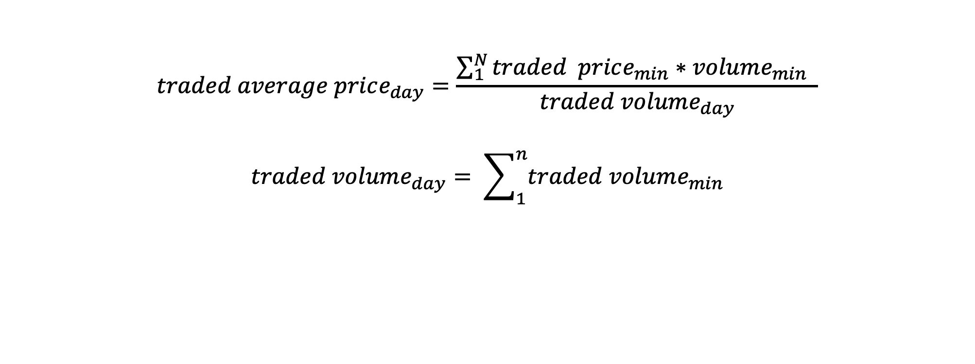
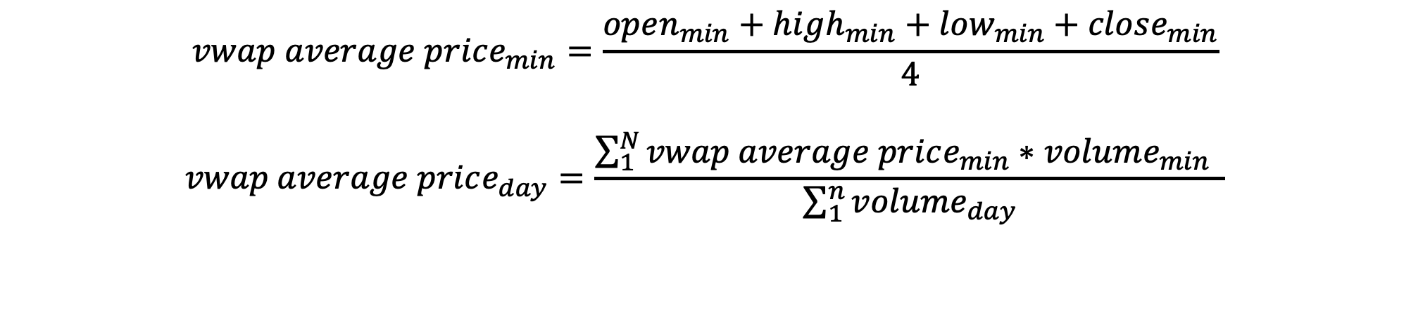
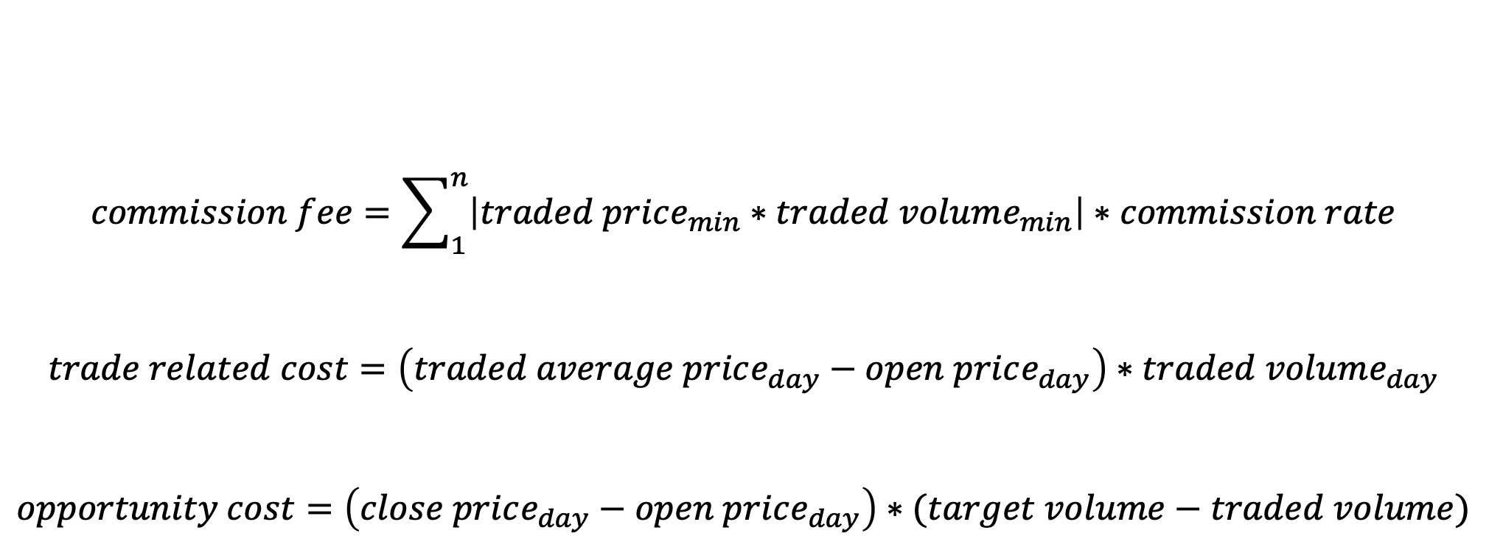

Cost Decomposition & Execution Quality
$$vwap average price_{min}=\frac{open_{min}+high_{min}+low_{min}+close_{min}}{4}$$
$$vwap average price_{day}=\frac{\sum_{1}^{N}{vwap average price_{min}∗volume_{min} }}{\sum_{1}^{n}{volume_{day}}}$$
$$commission fee=\sum_{1}^{n}{\left|traded price_{min}∗traded volume_{min}\right|∗commission rate}$$
$$trade related cost=\left(traded average price_{day}−open price_{day}\right)∗traded volume_{day}$$
$$opportunity cost=\left(close price_{day}−open price_{day}\right)∗(target volume−traded volume)$$
$$traded average price_{day}=\frac{\sum_{1}^{N}{traded price_{min}∗volume_{min} }}{traded volume_{day}}$$
$$traded volume_{day}= \sum_{1}^{n}{traded volume_{min}}$$
$$traded average price_{day} ?vwap average price_{day}$$

Slide 17
04
GUI System
Current Holdings & Trade Log & TCA Analysis

Slide 18
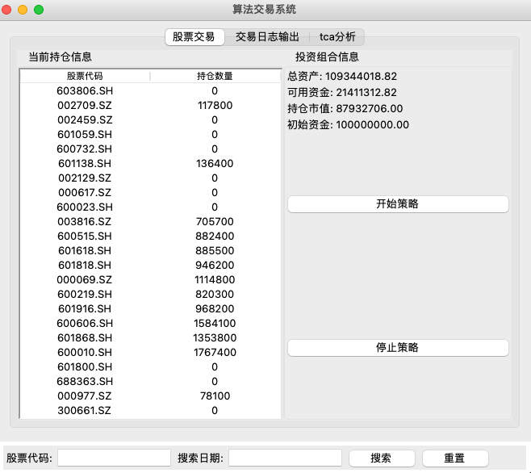
Current Holdings

Slide 19
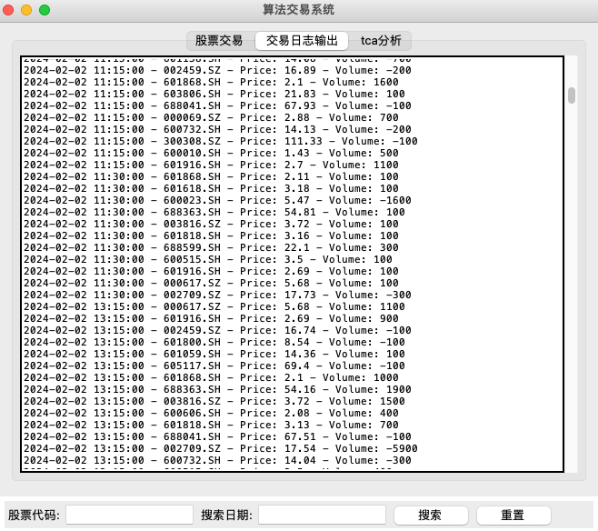
Trade Log

Slide 20
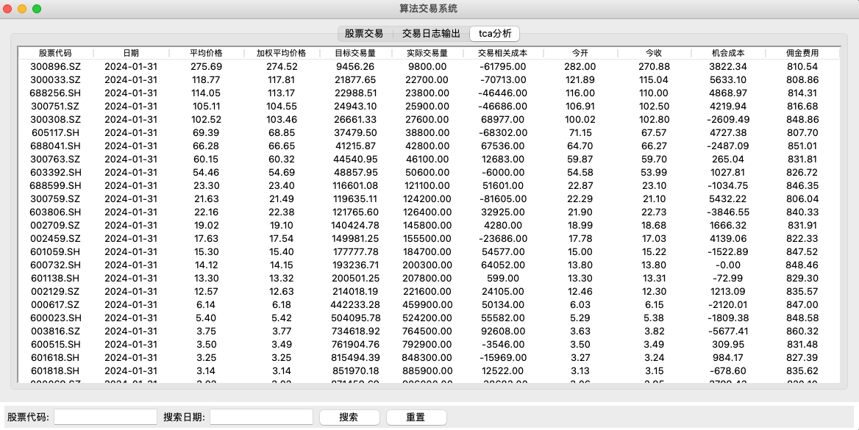
TCA Analysis

Slide 21
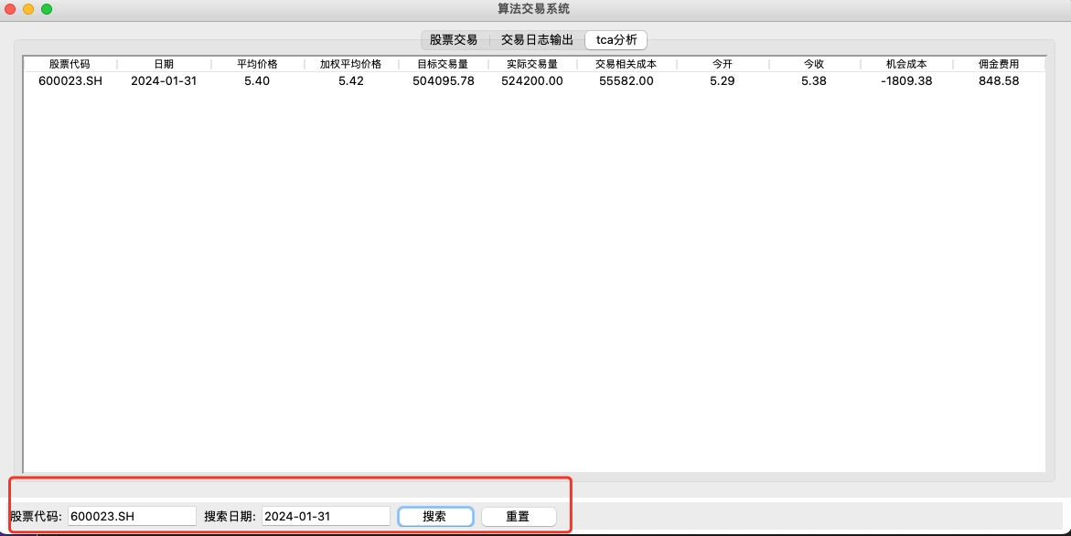
TCA Analysis

Slide 22
05
Results
Return & Sharpe & MDD

Slide 23
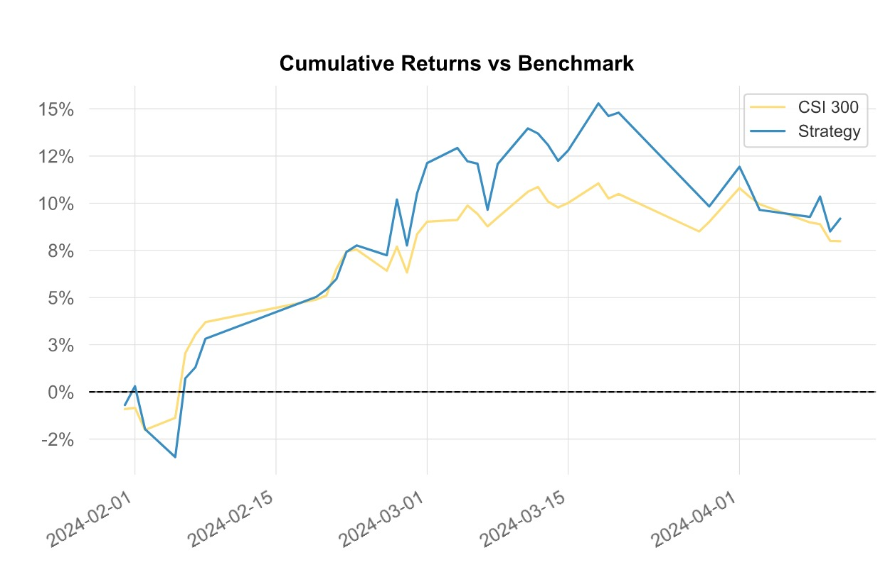
Strategy Effect
Key Indicator
Using the aforementioned algorithmic trading model, the strategy has a better effect than the CSI 300 index and obtains excess returns
In terms of stability, it is also better than the index, which can be seen by indicators such as volatility
Key performance Metrics
Metrics | Strategy
Cumulative Return | 9.19%
Sharpe | 2.32
Max Drawdown | -5.89%
Volatility(ann.) | 25.9%

Slide 24
Thanks for Listening！

